Slide 1
DATA 200
Oliver Reidmiller & Billy Wilkerson

Slide 2
Topics
Relational Databases
Primary v. Foreign Key
SQL
Keywords
Subqueries
Connecting to Database
Hierarchal Data
3 Main Data Models = Tabular, Hierarchical, Relational
Tabular Data
Python –
JSON
Numpy (Arrays)
Dictionary of Lists (DoL) & Lists of Lists (LoL)
Pandas
Tabular Data Formats

Slide 3
Working with Data

Slide 4
JavaScript Object Notation (JSON)
Text format used for storing and transporting data
Extremely common in data systems
Programming language independent
Allows us to write data into a test file and read that data into a data structure

Slide 5
NumPy
Acronym for “Numerical Python”
Package for data analysis
ndarray – an n-dimensional array object integral to NumPy package
A fixed size (specified at creation)
Elements must be of same data type
Rules allow for advanced operations to be performed quickly
Vectorization – replacing explicit loops with array expressions
Numpy uses the data representation NaN (Not a Number) for missing values

Slide 6
Important Operations in NumPy
Changing datatype
Indexing and slicing arrays
Creating 2D arrays by passing a list of lists into array function
Reshaping arrays – doesn’t change original shape of array
Resizing arrays – changes original shape of array
Basic statistics
Create higher dimensional arrays
Broadcasting between arrays of different dimensionality

Slide 7
Tabular Data

Slide 8
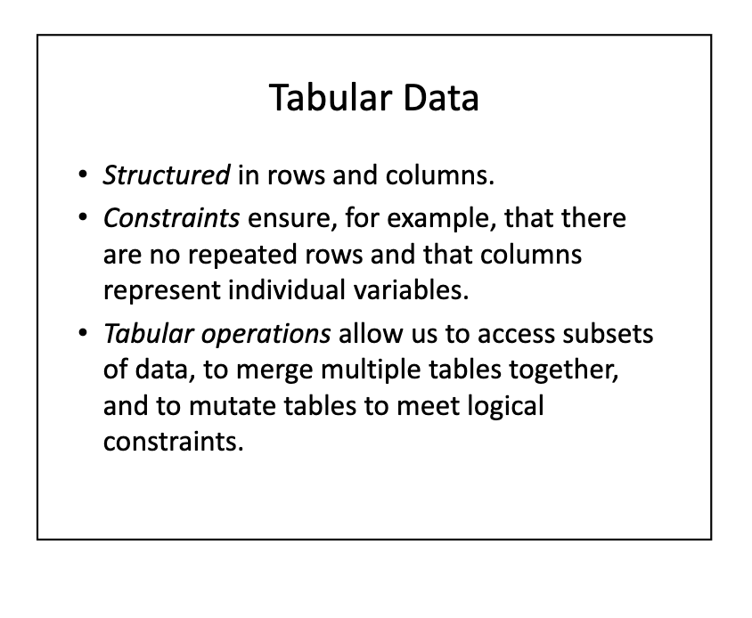
Tabular Data Model
Data is structured in rows and columns
Seeing rows and columns doesn’t always mean data is tabular
Each column provide values for the same property of the things described by each row
Each row contains the same variables (can be empty)
Commonly formatted as .csv or variants

Slide 9
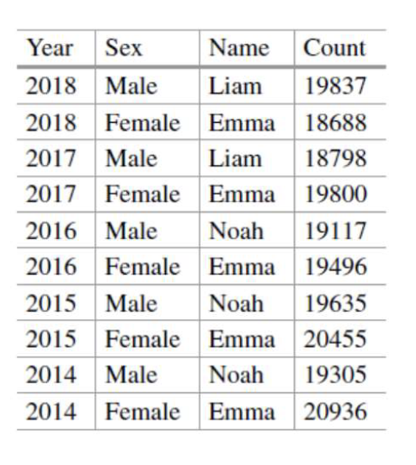
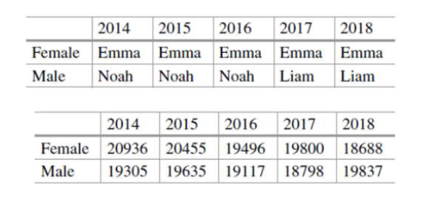
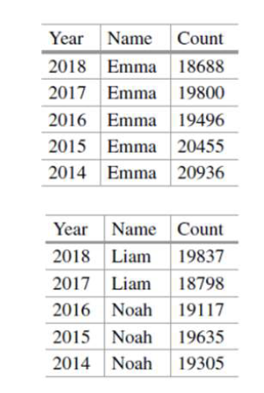
Example from Course Notes – Top Baby Names

Slide 10
Tabular Model Constraints
Tidy Data
1. Each variable must have its own column.
2. Each observation must have one unique row.
3. Each value must have its own cell.
Specific constraints

Slide 11
Tabular Data in Python
Tabular data can be represented with native Python data structures
Dictionary of lists
+ easy to access and manipulate entire columns
- hard to work with rows
List of lists
+ easy to access and manipulate rows
- hard to work with columns

Slide 12
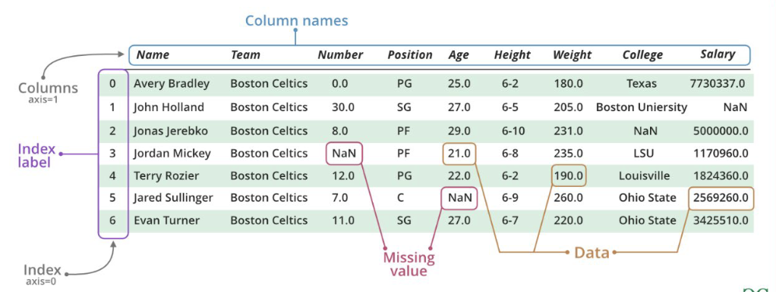
Pandas Data Structures
Module made to fix this issue, introduces new data structures
Missing data is handled as NaN, like in NumPy
Series - one-dimensional array of indexed data
Dataframe – two-dimensional array of data
Index and column names are mutable

Slide 13
Pandas Operations
Access operations – operations that allow us to select certain features or rows from the dataset (e.g. loc, iloc, [])
Column operations – operations that allow us to create and delete columns
Aggregation – partitioning operations that allow us to summarize subsets of a variable

Slide 14
Combining datasets in Pandas
Combining tables – allows us to concatenate datasets along row dimension or column dimension
Joining data frames – allows us to combine data frames by more complicated methods than concatenation (more on types of joins later)
Merging data frames – combining tables by the values in a regular column (not part of an index)

Slide 15
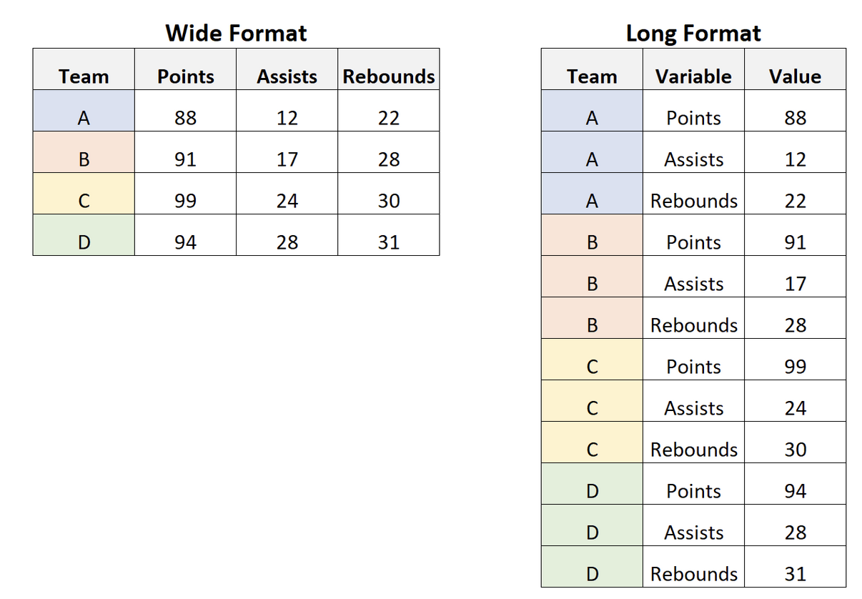
Transforming Tabular Data
Long vs Wide Data
Long considered better for storage
Wide is better for analysis, reducing dimensionality
Tabular transformations with Pandas
Transpose – swapping rows/columns
Melt (wide > long)
Pivot (long > wide)
Figure from statology.org

Slide 16
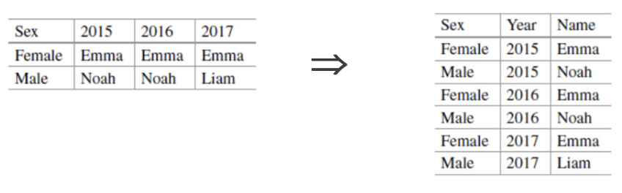
Melt Example from Course Notes

Slide 17
Relational Data

Slide 18
Relational Data Model
Multiple database tables containing keys to uniquely identify individual records/rows.
Primary Key – uniquely identifies each row in that table.
Foreign Key – connects rows to another data table (the primary key of the other table)

Slide 19
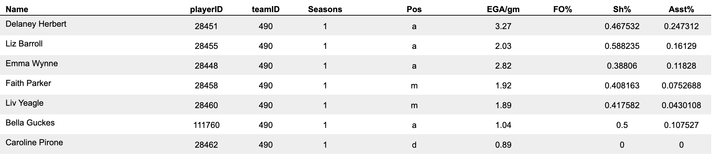
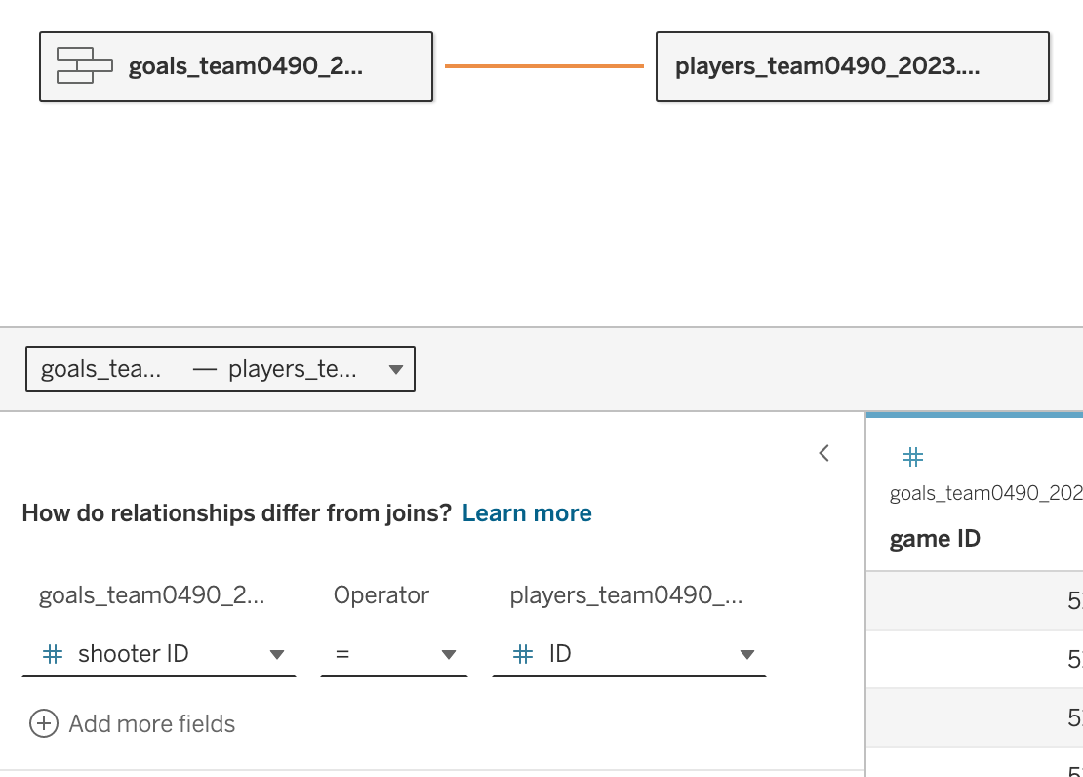
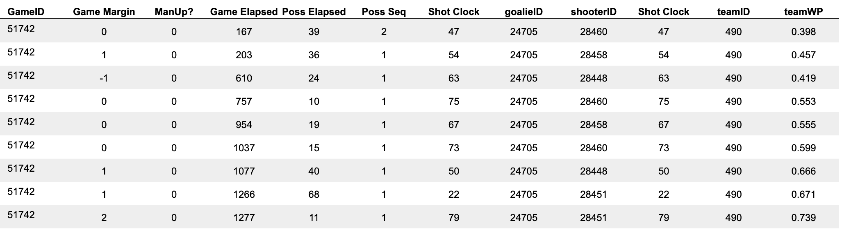
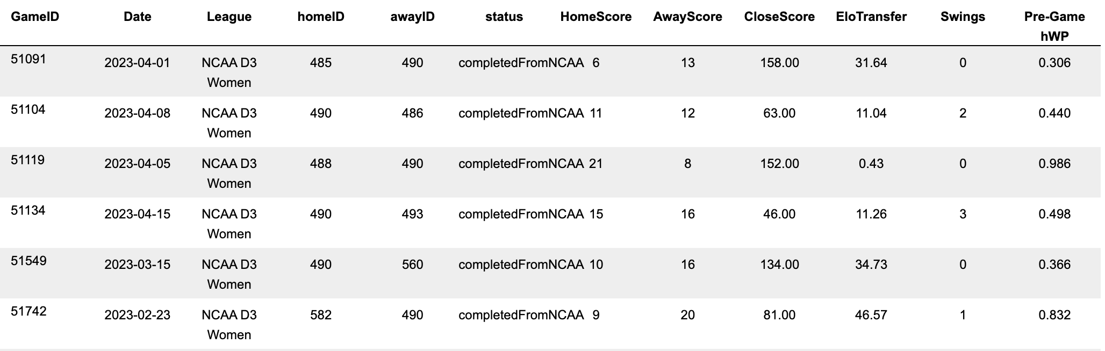
Example
Players
Goals
Games

Slide 20
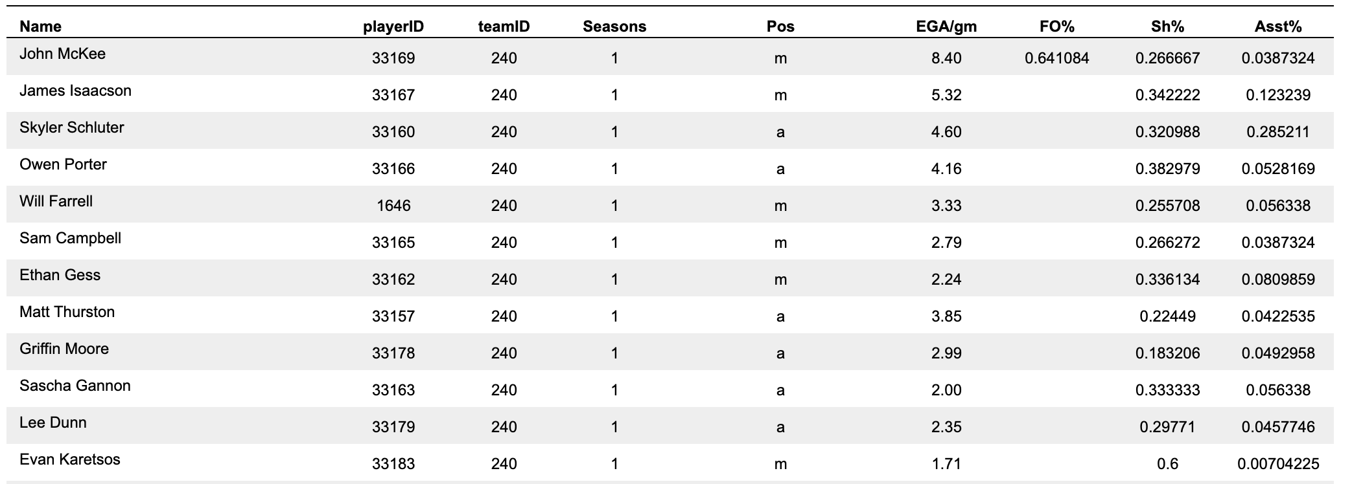
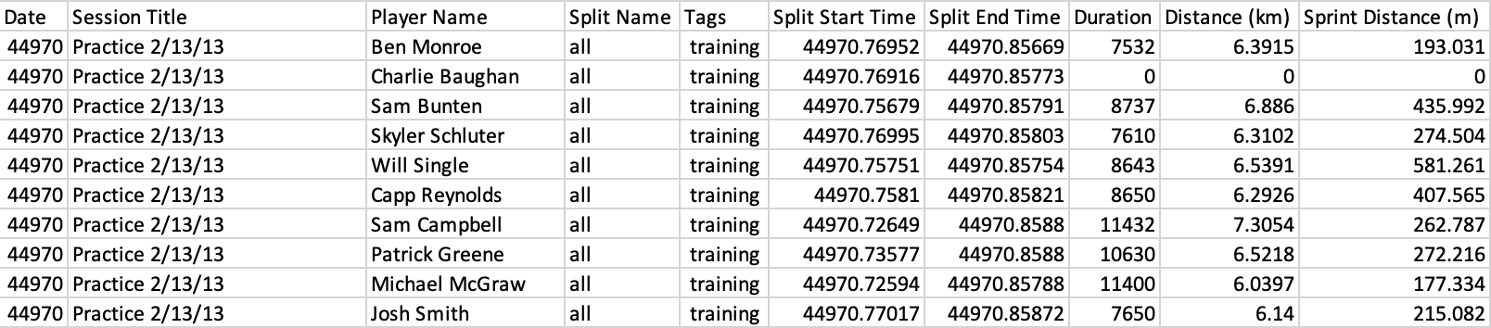
Example
Keys should be standardized and unique to preserve data integrity and accuracy.

Slide 21
SQL
Specialized to handle structured data that follows the relational data model used to interact with relational databases to manage and manipulate data.
Advantages
Declarative language – easy to use
Can handle large amounts of data
Standard for most database systems
Keys ensure data integrity and accuracy

Slide 22
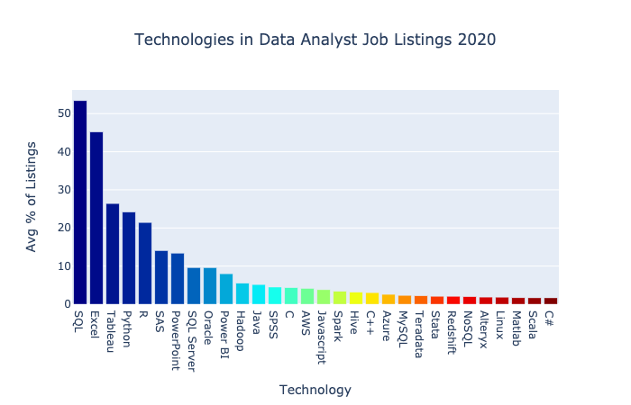
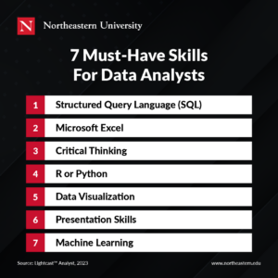
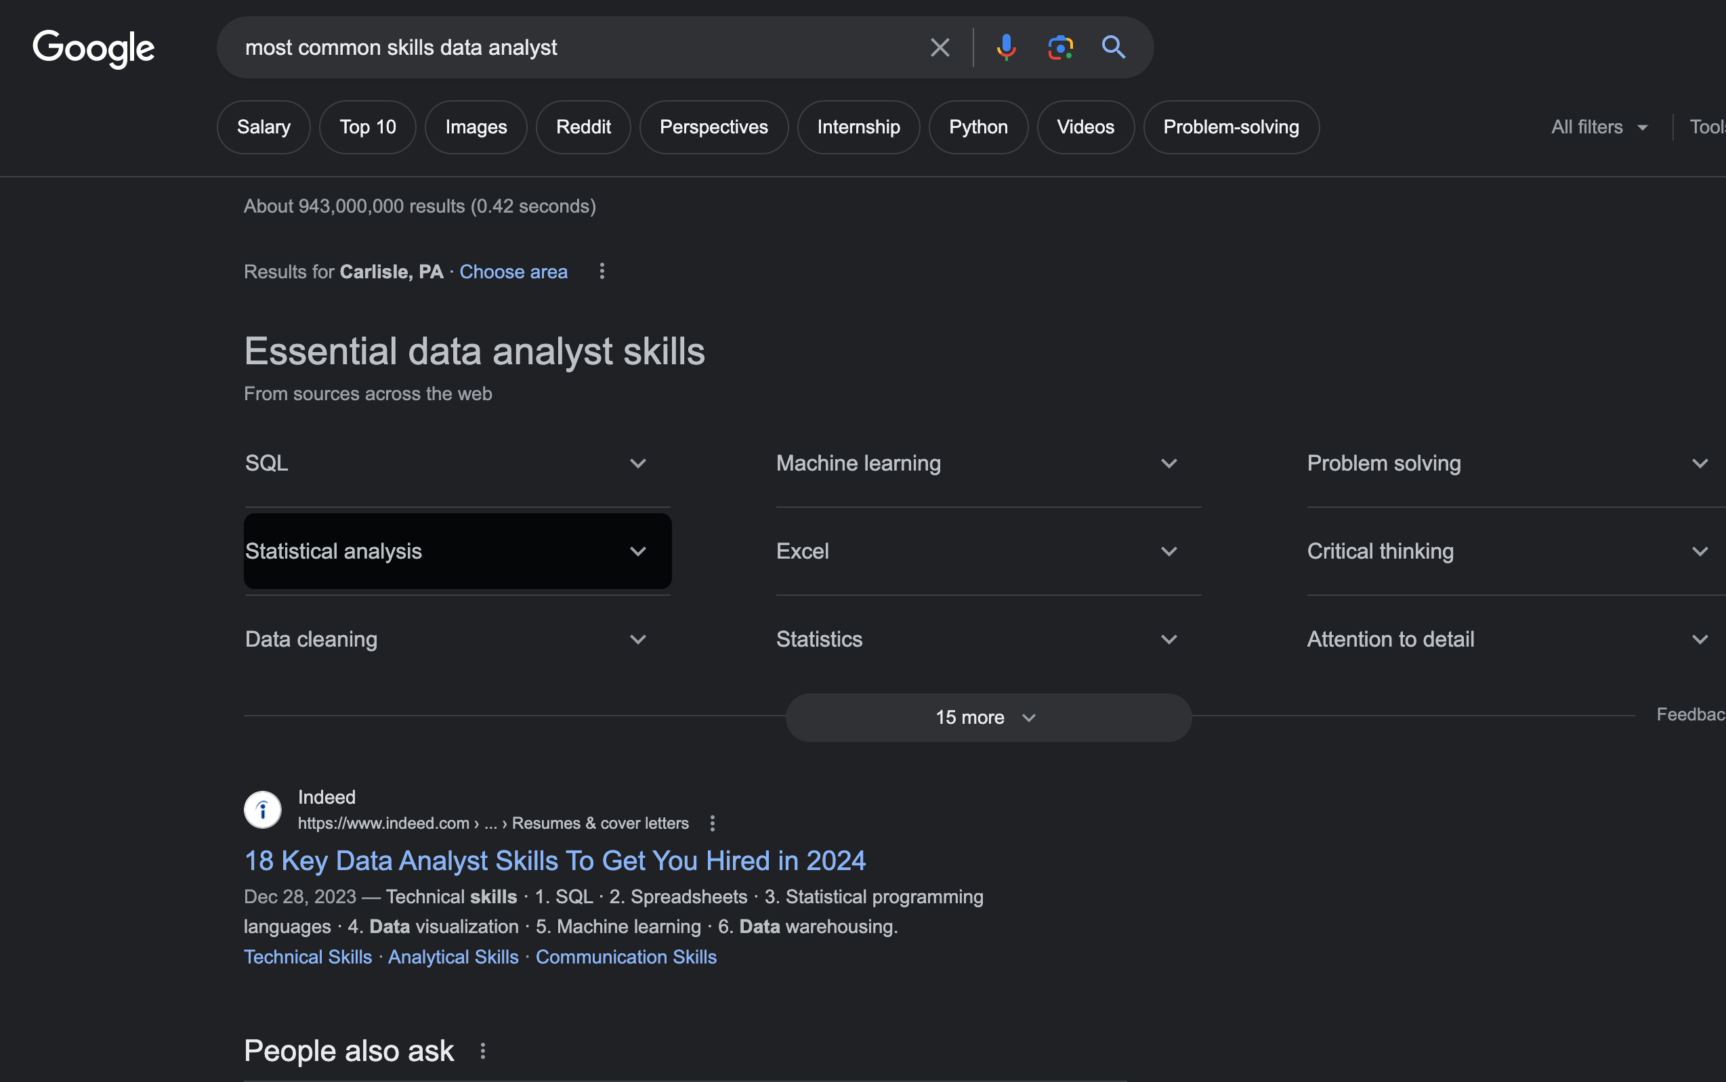
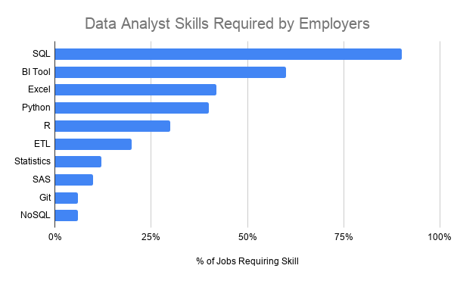

Slide 23
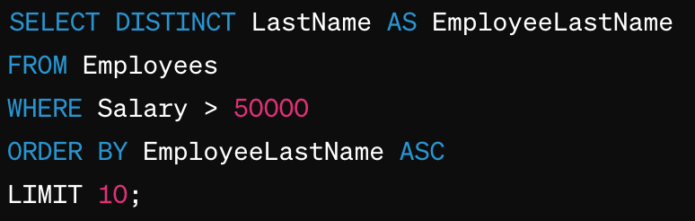
SQL Keywords
SELECT: Used to query and retrieve data from one or more tables in a database.
LIMIT: - Specifies the maximum number of rows to return in the result set of a query.
AS: - renames an existing column to make it more readable or names new columns from manipulating other columns
*: Indicates all columns should be selected in a SELECT statement
ORDER BY: - Sorts the result set of a query based on one or more columns, either in ascending (ASC) or descending (DESC) order.
DISTINCT: - Filters duplicate values from the result set, ensuring that only unique values are displayed.
WHERE: - Specifies a condition to filter rows in the result set based on a specified criterion.
“NOT EQUAL” = <>
SELECTS all DISTINCT last names FROM the Employees table and renames them AS EmployeeLastName.
Only selects employees WHERE their Salary >$50,000.
ORDER BY EmployeeLastName in ascending (ASC) order (Alphabetical)
LIMIT query to first 10 rows

Slide 24
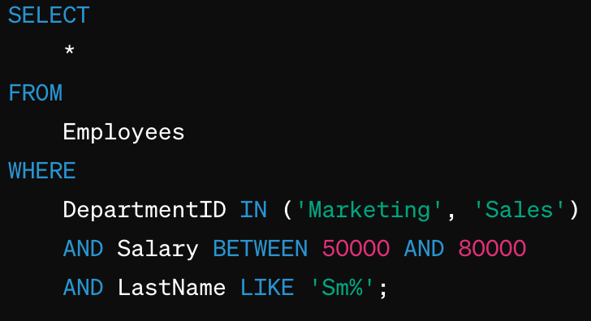
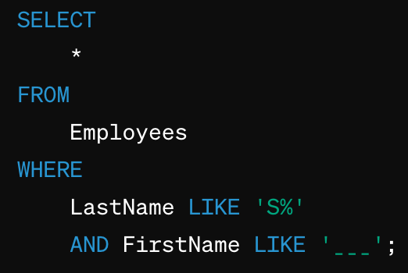
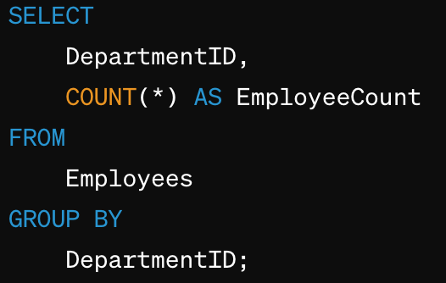
More SQL Keywords
BETWEEN: Filters the result set to include only rows whose column values are within a specified range.
IN: Allows you to specify multiple values in a WHERE clause, equivalent to multiple OR conditions.
LIKE: Used in a WHERE clause to search for a specified pattern in a column.
% (Wildcard): matches any sequence of characters.
Can be before, after, in middle of any string.
_ (Underscore): matches any single character
COUNT: Returns the number of rows that satisfy a specified condition. It can be used with or without GROUP BY to count all rows or rows within groups.
GROUP BY: Groups rows that have the same values in specified columns into summary rows, typically used with aggregate functions like COUNT, SUM, AVG, etc.

Slide 25
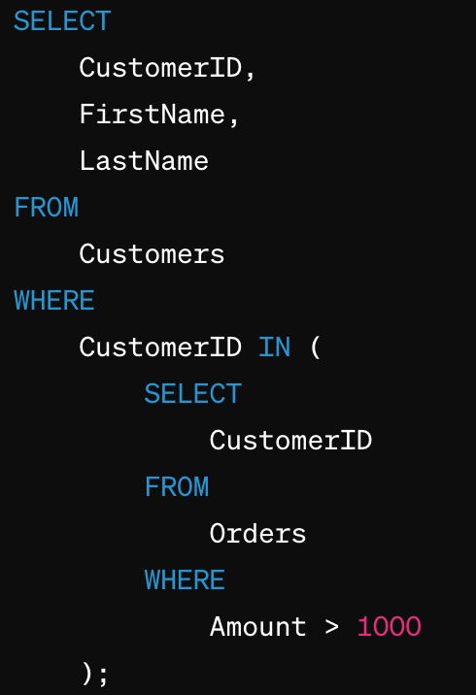
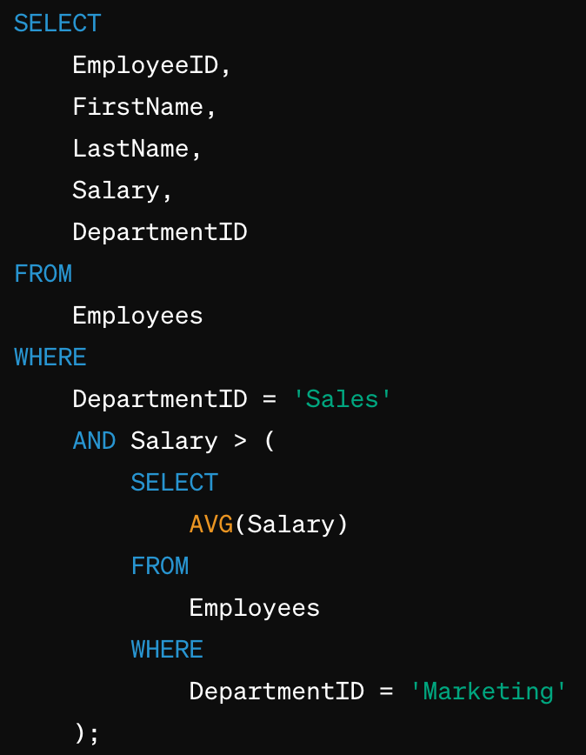
Subqueries
Finds all employees from the Sales department whose salary is greater than the average employee from the Marketing department.
Finds customers who spent more than $1,000 by referencing another table

Slide 26
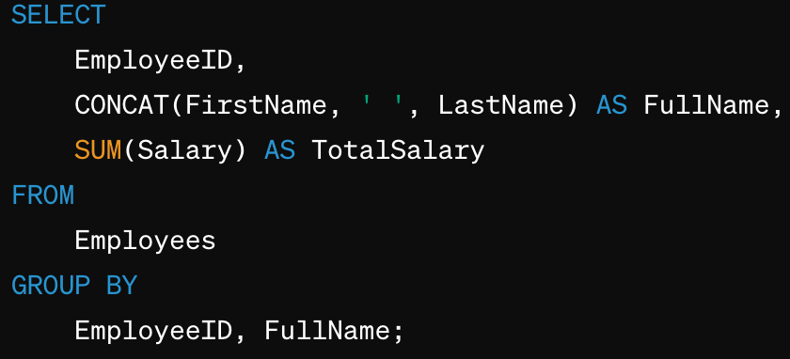

Concatenation and Aggregation
Concatenation: combining 2 or more strings into a single string
Aggregation: combining 2 or more rows into a specific result using an operation
SUM()
AVG()
COUNT()
MIN()
MAX()

Slide 27
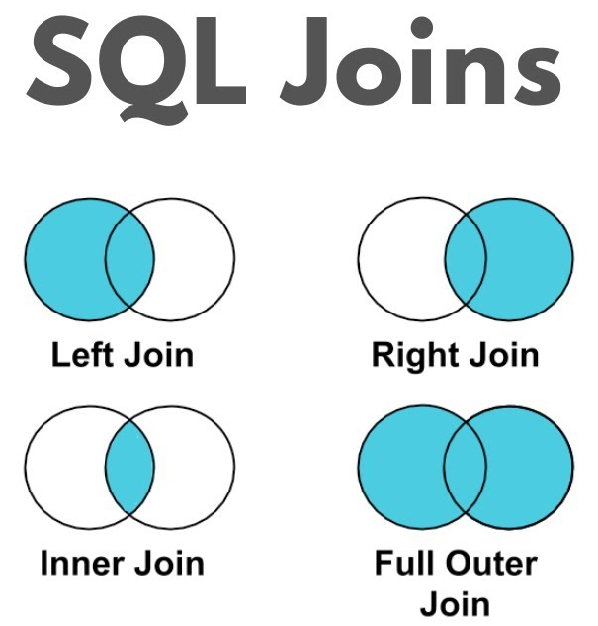
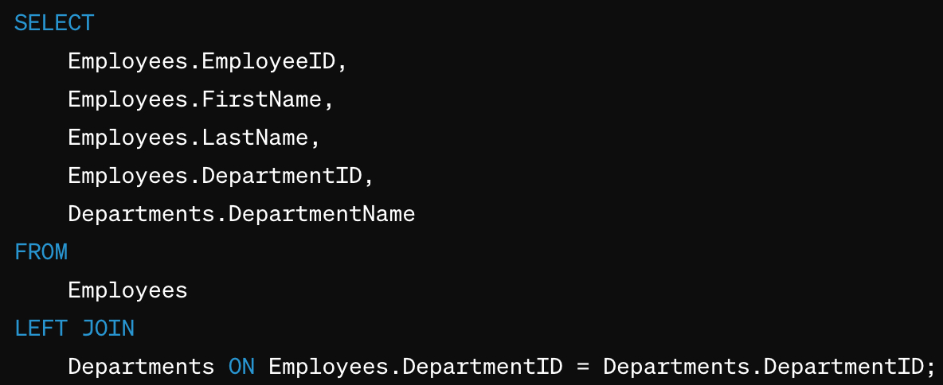
Join Variations: Left Join
Include all rows from left table and matching rows from the right table.
Right table will contain NULL values if there is no match to the left table.
Does not include rows unique to right table
Primary Key = Employee ID
Foreign Key = Department ID
All employees from Employees and matches them with their department
Will not include Department Names not present in employees

Slide 28
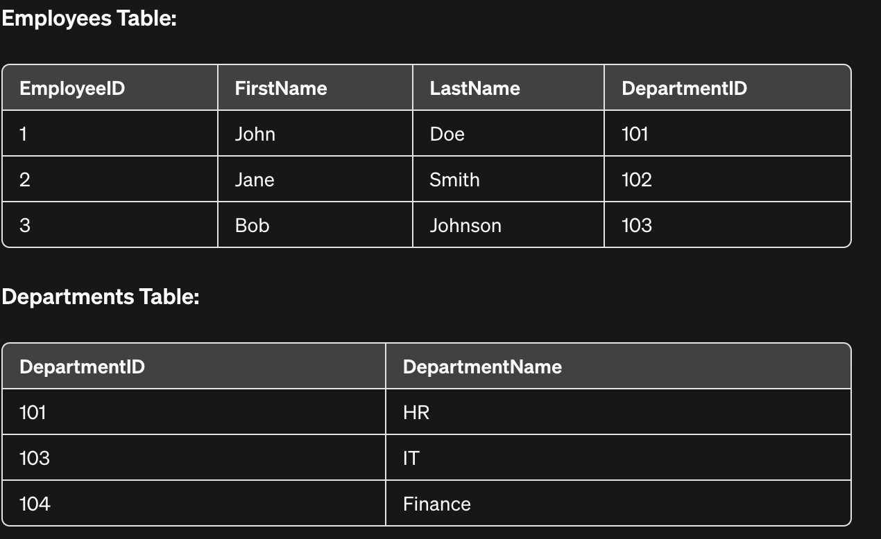
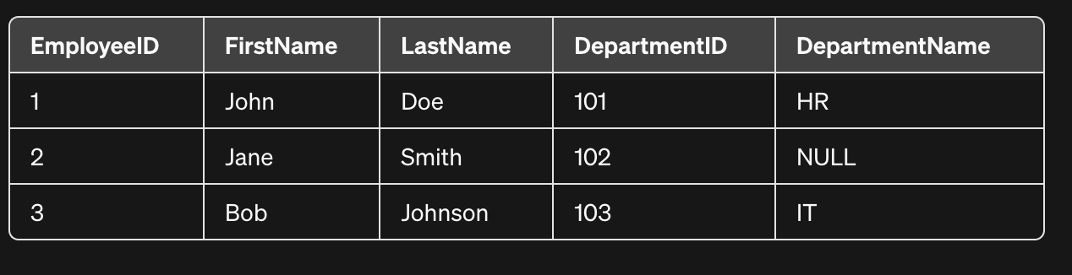
Join Variations: Left Join

Slide 29
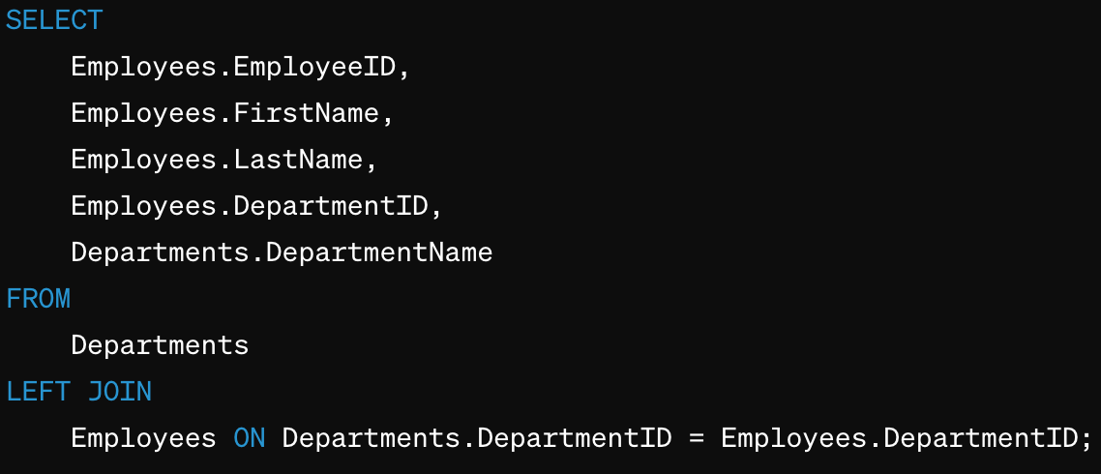
Join Variations: Right Join
Include all rows from right table and ONLY matching rows from the left table.
Left table will contain NULL values if there is no match to the left table.
Does not include rows unique to Left table
LEFT JOIN with swapped tables
Primary Key = Department ID
Foreign Key = Department ID
All rows from Department and matches them with their employees

Slide 30
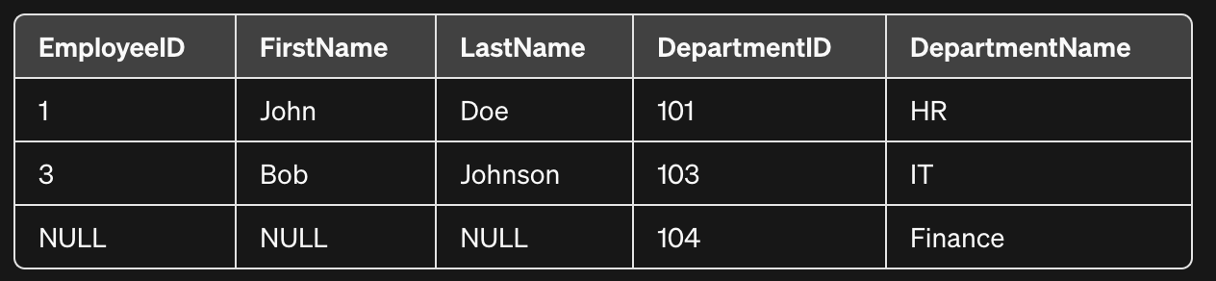
Join Variations: Right Join

Slide 31
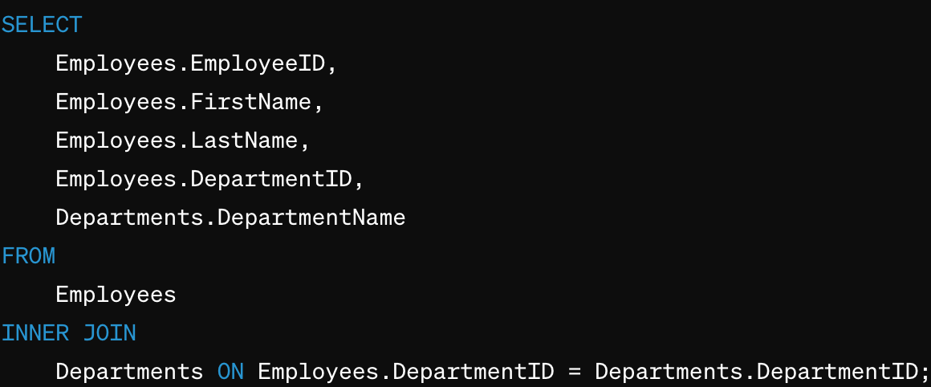
Join Variations: Inner Join
Includes only rows with matches in both tables
No NULL values
Does not include rows unique to left or right table
Primary Key = Employee ID
Foreign Key = Department ID
Any rows without a match between tables using DepartmentID are excluded

Slide 32
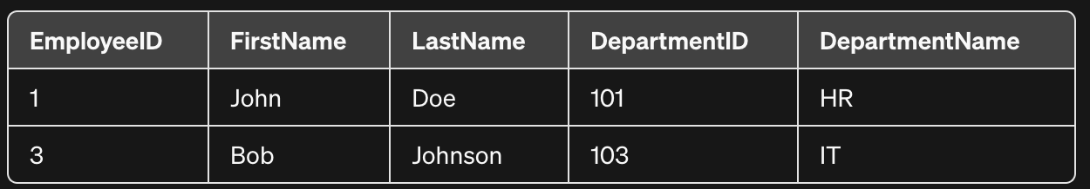
Join Variations: Inner Join

Slide 33
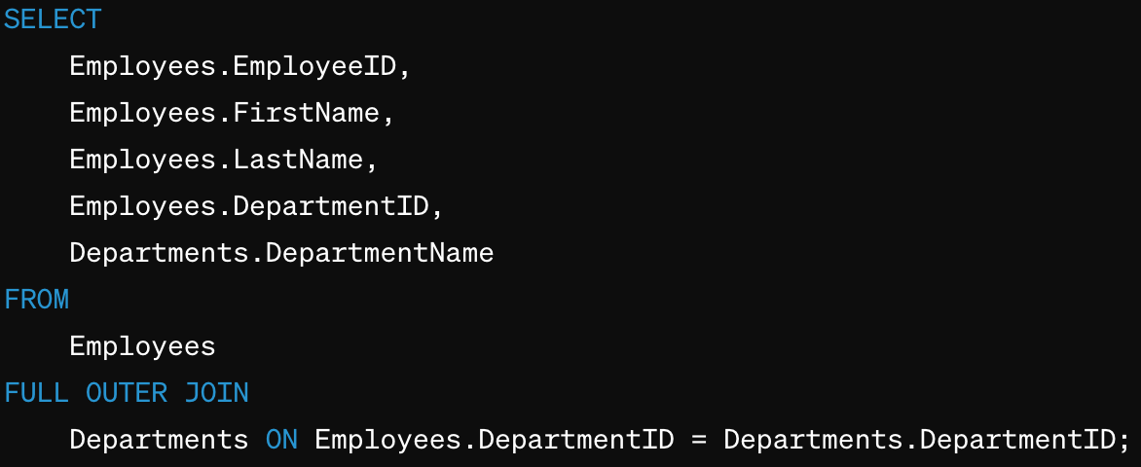
Join Variations: Outer Join
Includes ALL rows from each table
Includes rows unique to ALL tables
Unmatched rows will receive NULL values from the columns of the other table
Primary Key = Employee ID
Foreign Key = Department ID
Not all database systems support FULL OUTER JOIN, they require using LEFT OUTER JOIN and UNION

Slide 34
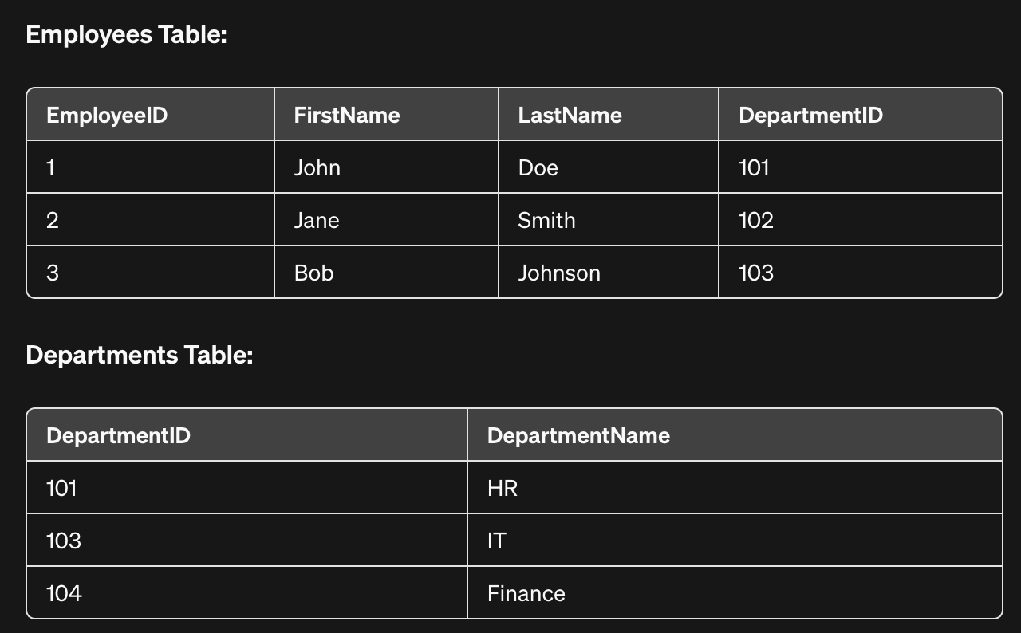
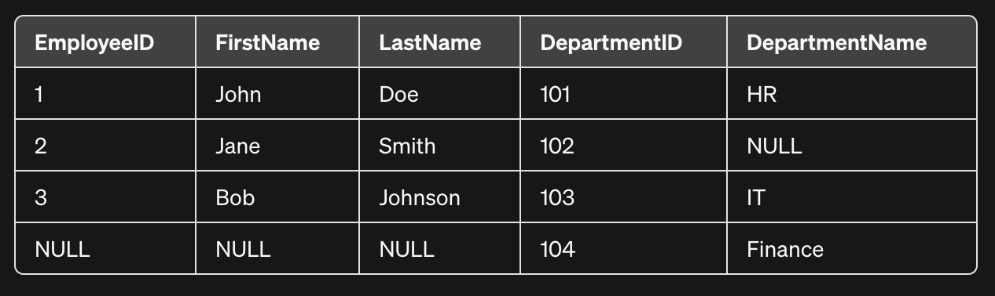
Join Variations: Outer Join

Slide 35
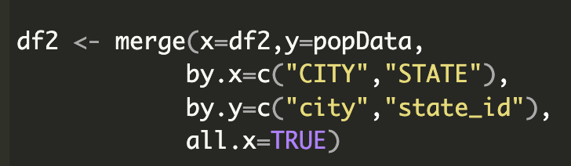
R - Left Join using Merge

Slide 36
Resources
SQL Subreddit
Python Reference Sheet
More Python Reference Sheets

Slide 37
Course Feedback
Teaches the most applicable skills for data analyst jobs.
Python, SQL
Use more SQL in other courses and more in this course.
SQL is more present in data analysts.

